Slide 1


MRF TYRES FINANCIAL ANALYSIS REPORT
~ Under Supervision of: Prof. Niranjan Swain

Slide 2

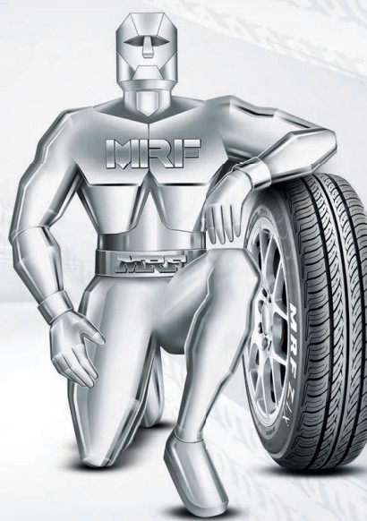
MRF Ltd. - Intoduction
MRF Ltd. (Madras Rubber Factory), founded in 1946 by K.M. Mammen Mappillai in Chennai, India, is one of the country's largest tyre manufacturers and a significant player globally. Renowned for its quality products, MRF has diversified into producing conveyor belts, paints, and toys, including the popular Funskool brand. The company also makes coats and retreads, expanding its industrial range.
Global Presence
Market Reach - MRF's products are available in over 65 countries across the globe, including markets in Europe, the Middle East, Asia, Africa, and the Pacific.
R&D Facilities - With 3% of its annual revenue being employed in R&D activities, its R&D department is among the most advanced in Asia, reflecting the company's commitment to innovation.
Manufacturing Facilities - MRF has eight manufacturing plants located strategically across India, including major sites in Chennai, Tiruvottiyur, Kottayam, Puducherry, and Medak.
Production Capacity - MRF, with the ability to produce over 15 million tyres annually, has a significant production capacity.
Technological Innovations
Manufacturing Innovations - The company employs state-of-the-art automation and advanced curing techniques, ensuring high precision and quality in production.
Motorsports and Racing Teams - MRF's active involvement in motorsports boosts its brand and enables real-world testing of its tire technologies under extreme conditions.

Slide 3
Industry Analysis
MICHAEL PORTER’S 5 FORCES
RIVALRY AMONG EXISTING FIRMS
THREAT OF ENTRY OF NEW FIRMS
THREAT OF SUBSTITUTE PRODUCT OR SERVICES
3
BARGAINING POWER OF BUYERS
4
BARGAINING POWER OF SUPPLIERS
5
1
2
High
80% market share with top 4 players.
Consolidation expected and industry nearing maturity.
LOW, due to high entry barriers like,
Force of rivalry High Risk
High Raw material costs Highly Capital intensive.
LOW, but increasing because of,
Retreading Import of Chinese Tyres ISI mark made compulsory
OEM’S - LOW
Switching Costs
- LOW
In Replacement Markets - MODERATE
Number of Suppliers - LOW Switching Costs
- HIGH
Availability of raw material substitutes - LOW

Slide 4
Generic Corporate Strategy Analysis
COST LEADERSHIP
DIFFERENTIATION
Investments in R&D for high-performance
Large-scale operations reduce per-unit costs. Bulk purchasing and diversified product range.
MRF produces over 30 million tyres annually.
PRODUCT
ECONOMIES OF SCALE
QUALITY AND INNOVATION
tyres.
Collaborations with automotive manufacturers.
MRF invests ₹150 crores annually in R&D.
Modern plants and automation enhance efficiency.
Continuous improvement initiatives like Lean Manufacturing.
MRF's Chennai plant is among the most advanced globally.
Strong reputation for reliability and quality.
Sponsorship of major sports events. MRF's brand value is estimated at ₹8,000 crores.
EFFICIENT PRODUCTION
BRAND IMAGE
Strategic sourcing and long-term supplier relationships.
Backward integration for cost control.
MRF owns rubber plantations, reducing raw material costs by 15%.
Comprehensive after-sales support. Customer-centric initiatives ensure satisfaction.
Over 5,000 service points across India.
LOWER INPUT COSTS
CUSTOMER SERVICE

Slide 5
Generic Corporate Strategy Analysis
CORE COMPETENCIES
VALUE CHAIN ACTIVITIES
ADVANCED
R&D
Continuous innovation in tyre design. Dedicated R&D center.
MRF holds over 100 patents in tyre technology.
INBOUND LOGISTICS
Efficient procurement and inventory management.
Strategic supplier partnerships.
95% on-time delivery from suppliers.
BRAND EQUITY
Recognized for quality and reliability. Trust and performance in the tyre industry. MRF ranked as India's No.1 tyre brand for 14 consecutive years.
State-of-the-art manufacturing facilities. Advanced manufacturing technologies.
MRF's plants operate at 85% capacity utilization.
OPERATIONS
DISTRIBUTION NETWORK
OUTBOUND LOGISTICS
Comprehensive after-sales support. Customer-centric initiatives ensure satisfaction.
Over 5,000 service points across India.
Extensive network ensuring market reach. Availability in urban and rural areas.
MRF has over 4,000 dealers nationwide.

Slide 6
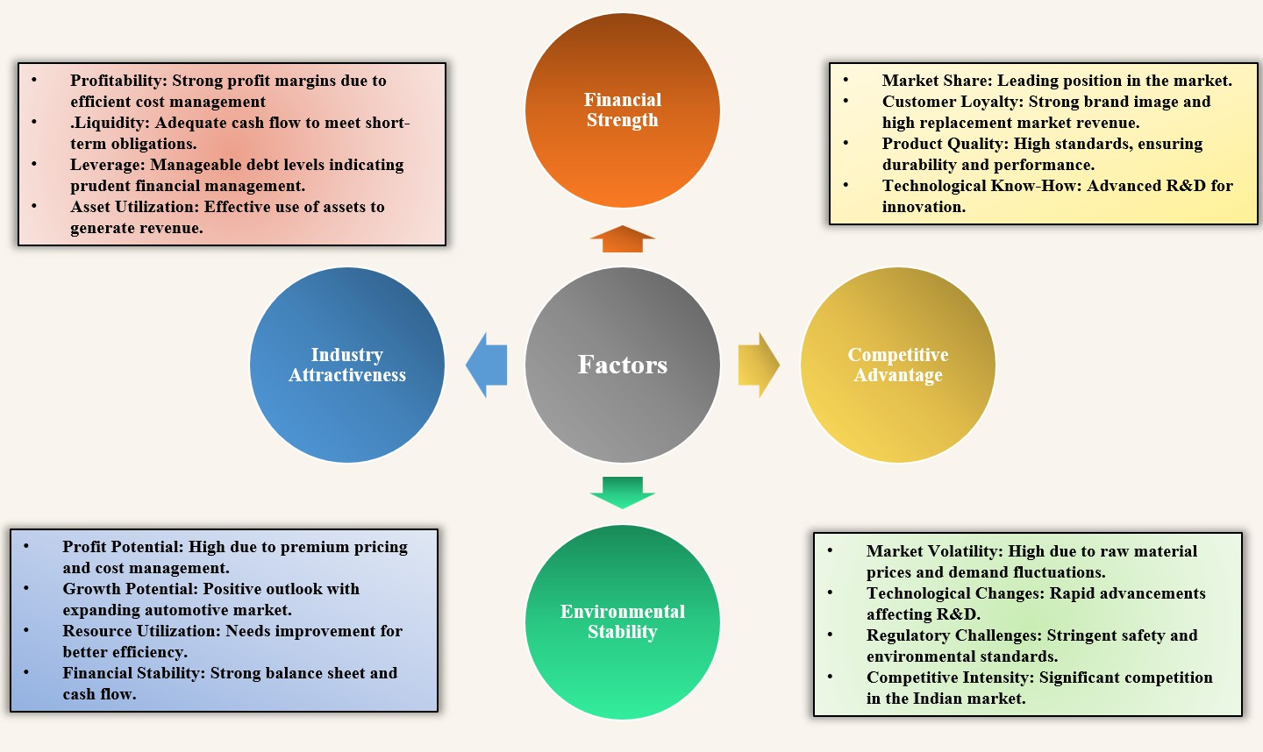
Strategic Position and Action Evaluation

Slide 7
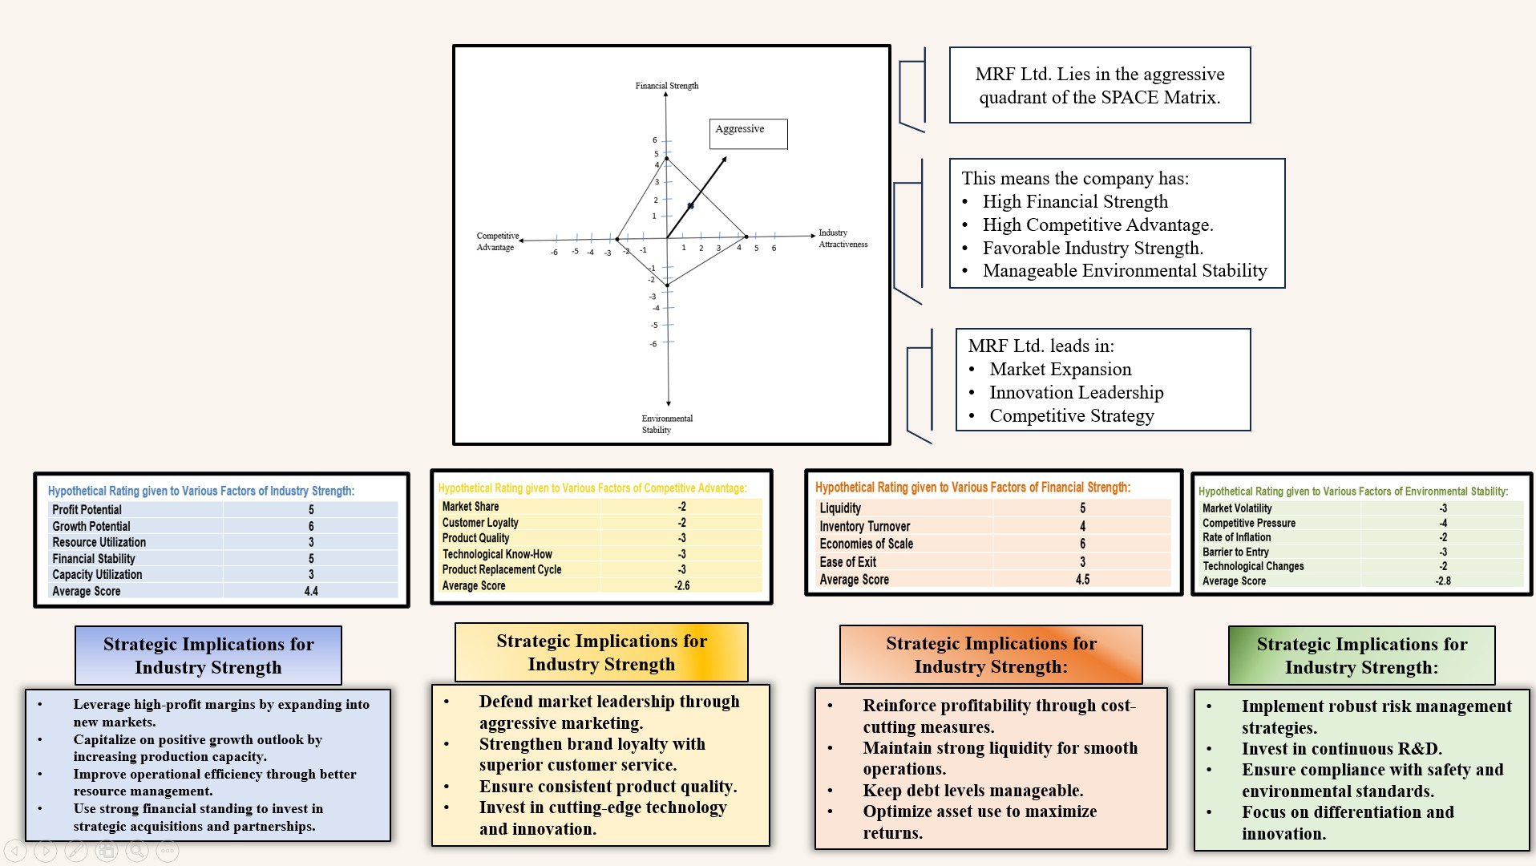
SPACE MATRIX

Slide 8
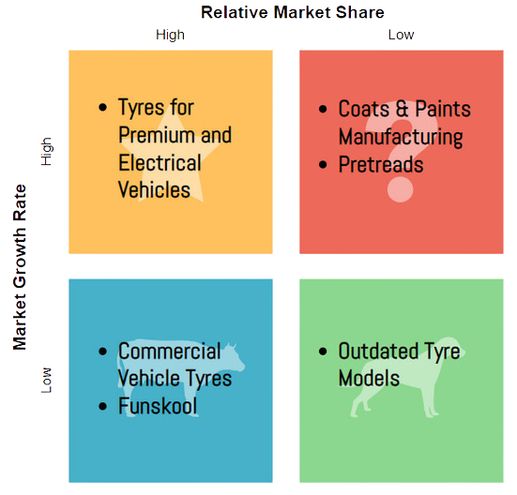


BCG Matrix
Stars:
Premium/Electric Vehicle Tyres
High growth, strong market share. Continue aggressive investment.
Cash Cows:
Commercial Vehicle Tyres
Stable market, dominant share.
Funskool
Strong in stable toy market.
Use profits to fund growth areas.
Question Marks:
Coats and Paints Manufacturing
Emerging market; decide on investment.
Pretreads
Growing market; evaluate strategic fit.
Dogs:
Outdated Tyre Models Consider discontinuing.
Underperforming Subsidiaries
Assess for divestiture or realignment.
Strategic Actions:
Invest: Focus on Stars and promising Question Marks
Harvest: Extract profits from Cash Cows.
Divest: Cut losses in Dogs.

Slide 9

Factors Affecting Growth of MRF LTD.
Major Competitive Advantages
Strong Brand Equity : MRF is one of the most recognized and trusted tire brands in India. Its long-standing reputation for quality and reliability has built strong brand loyalty among consumers. This brand equity translates into a significant competitive advantage, as customers are more likely to choose
Comparison to Key-Competitors
Mkt. Share Product Range
Target Demo.
Passenger vehicle tires, commercial, and two-wheeler tires.
Urban and rural consumers, OEM partnerships, replacement market.
MRF tires over lesser-known brands.
MRF Ltd.
30%
Extensive Distribution Network: MRF has a widespread and robust distribution network that spans across India and international markets. With a large number of dealers, retail outlets, and service centers, MRF ensures that its products are easily accessible to customers. This extensive network enhances market reach and customer convenience.
Apollo Tyres
Passenger and commercial vehicle tires, growing in two-wheelers.
Urban and rural markets, focused on safety, performance, and durability.
20%
High-Quality Standards: MRF is known for its stringent quality control measures and adherence to high-quality standards. The company’s commitment to quality ensures that its tires perform well under various conditions and have a longer lifespan. This reliability is a key factor in retaining customer trust and satisfaction.
Durable tires for passenger vehicles, commercial vehicles, and two-wheelers.
Budget-conscious customers, fleet operators, strong in replacement market.
CEAT Ltd.
15%
Tires for passenger cars, trucks, buses, and off-the-road vehicles.
Urban and semi- urban markets, OEM partnerships, expanding exports.
JK Tyres
12%
Commitment to Sustainability: MRF’s commitment to sustainable practices, such as eco-friendly tire production and waste management, enhances its reputation and aligns with the growing consumer preference for environmentally responsible brands. Sustainable practices also help MRF comply with regulatory requirements and reduce operational risks.
Premium tires for passenger vehicles and commercial segments with advanced technology.
Primarily urban, premium segment consumers, focused on high performance and safety features.
Bridgestone India
8%

Slide 10

Growth Stages
Analysis of Discrepency betwen Actual and Estimated Growth
Economic Factors: The economic environment, including growth rates, consumer spending, and industrial activity, significantly impacted MRF's performance. The pandemic had a particularly severe impact in FY21, while the recovery period in FY22 and FY23 led to higher-than-expected growth.
Market Dynamics: Changes in the automotive market, including vehicle sales trends and consumer behavior, influenced tire demand. The resurgence in automotive sales post-pandemic led to a surge in tire sales in FY22 and FY23.
Operational Challenges: Supply chain disruptions, raw material price volatility, and factory shutdowns affected production and sales. These challenges were pronounced during the pandemic but eased during the recovery phase.
Competitive Pressures: Increased competition from domestic and international tire manufacturers impacted market share and pricing strategies. Competitive pressures were likely higher in periods of slower economic growth.
Strategic Initiatives: MRF's strategic initiatives, such as new product launches, expanding distribution networks, and enhancing operational efficiency, played a role in achieving better-than-expected growth during the recovery period.
FY19
10.3%
2.80%
97.20%
10.01%
6.85%
FY20
11.6%
2.20%
97.80%
11.37%
0.97%
FY21
9.5%
3.40%
96.60%
9.16%
-0.44%
FY22
4.7%
9.82%
90.18%
4.24%
19.27%
FY23
5.6%
7.79%
92.21%
5.19%
18.9%
FY24
12.4%
3.64%
96.36%
11.96%
9.28%
Return on
Equity
Dividend Payout Ratio
Retention Ratio
Estimated Growth(%)
Actual Growth
Introduction of High-Performance Tires: Launching new models like the MRF Zapper and Perfinza series, targeting the premium segment with enhanced performance, safety, and durability features.
Diversification into New Segments: Entering new market segments such as tires for electric vehicles (EVs) and autonomous vehicles, anticipating future industry trends and demands.
Smart Tires: Introducing tires equipped with sensors to monitor tire pressure, temperature, and tread depth, providing real-time data to enhance safety and performance.

